Slide 1
1

Slide 2

APPLIED CRYPTOGRAPHY
Lecture 53
2

Slide 3
CBC-MAC
Message Authentication code
3

Slide 4
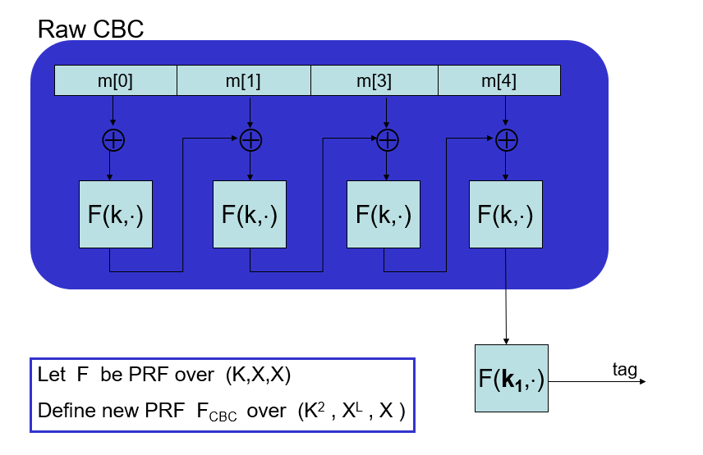
CBC-MAC

Slide 5
Why the last encryption step?
Suppose we define a MAC I_{RAW} = (S,V) where
S(k,m) = RawCBC(k,m)
Fact: I_{RAW} is easily broken using a chosen msg attack.
Adversary works as follows:
Pick an arbitrary one-block message m∈M
Request tag for m. Get t = F(k,m)
Output t as MAC forgery for the message (m, t⊕m)

Slide 6
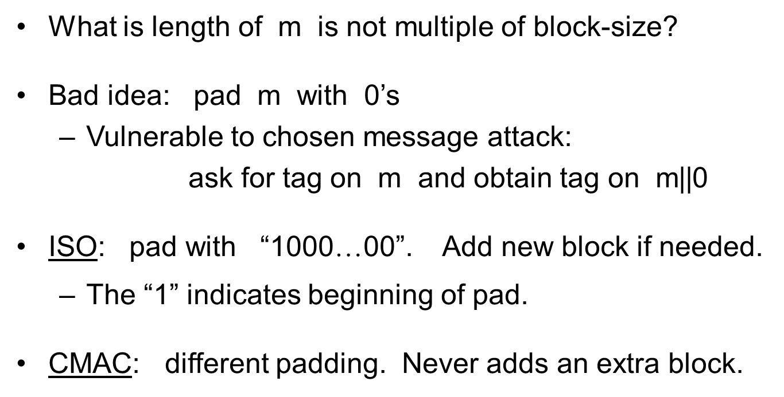
CBC-MAC Padding

Slide 7


Rajashree S
Computer Science and Engineering
PES University, Bengaluru
10 June 2020
7

